Slide 1


Area

Slide 2

LO: To identify the area of a shape
Success Criteria
I can count the squares
I can use multiplication to work out the answer
I can write the unit of measure after my answer

Slide 3

What does
Area
mean?

Slide 4

Area
A measure of how much space there is on a surface.
Area is measured in square units.

Slide 5
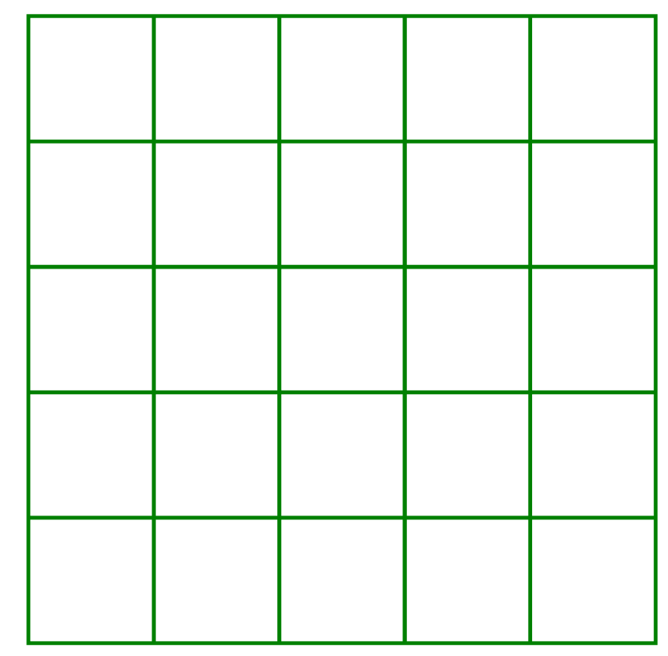
This square has sides that are 5 cm in length.
To find the area of the square we could count the squares. Or, a quicker way is to multiply the lengths of the two sides.
We need to remember to write the correct unit of measure – centimetres squared
For example…
5 cm
5 cm
5 cm x 5 cm = 25 cm
2
cm
2

Slide 6
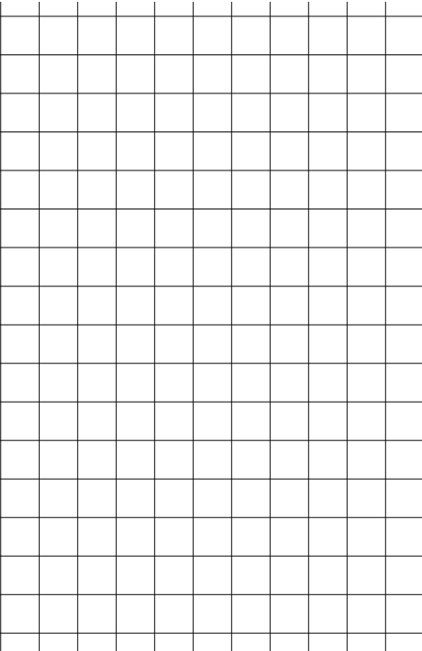
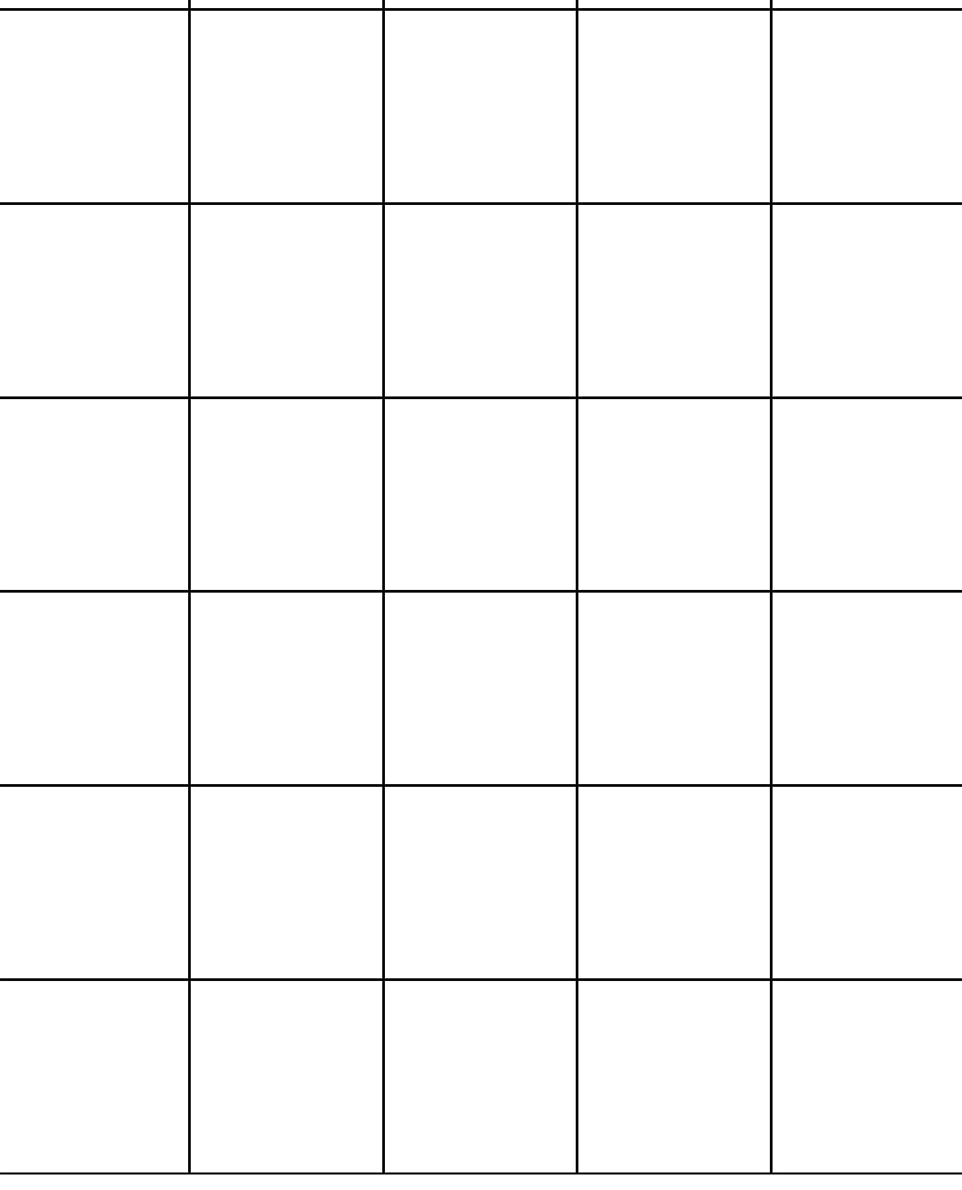

5 cm
6 cm

Slide 7
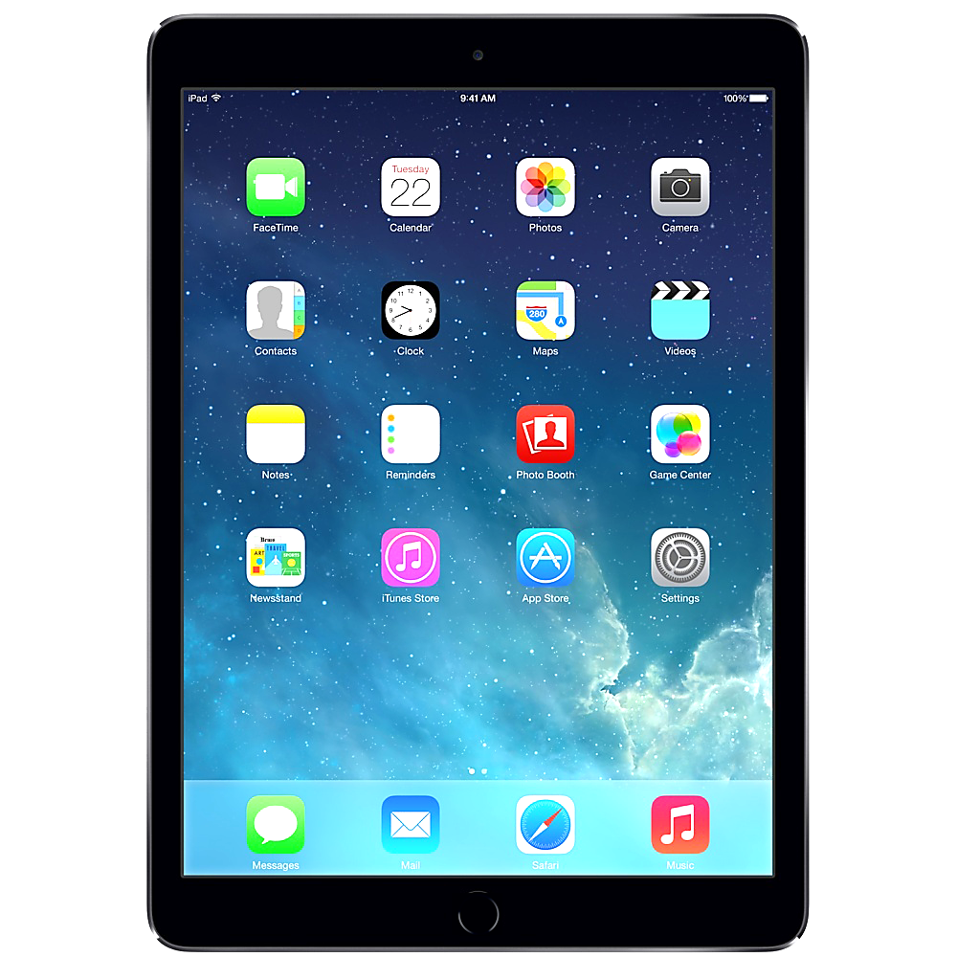
14 cm
20 cm

