Slide 1
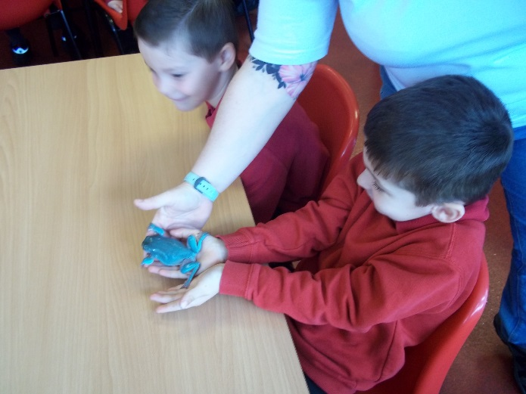
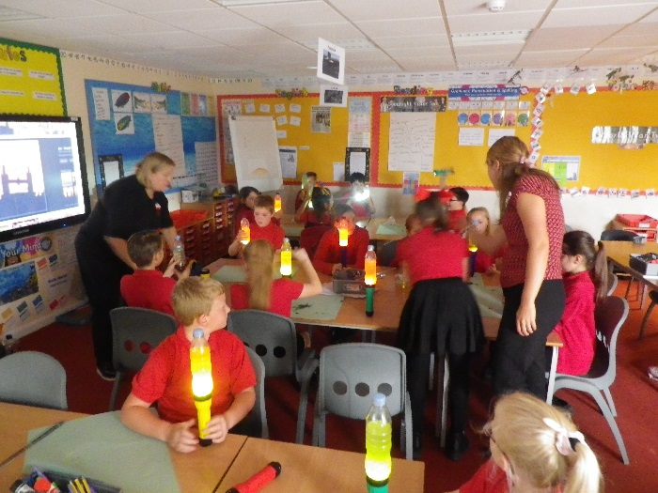
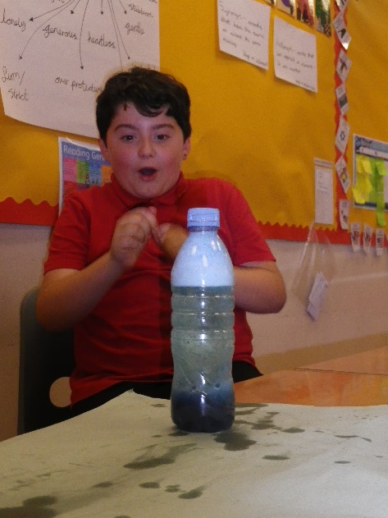
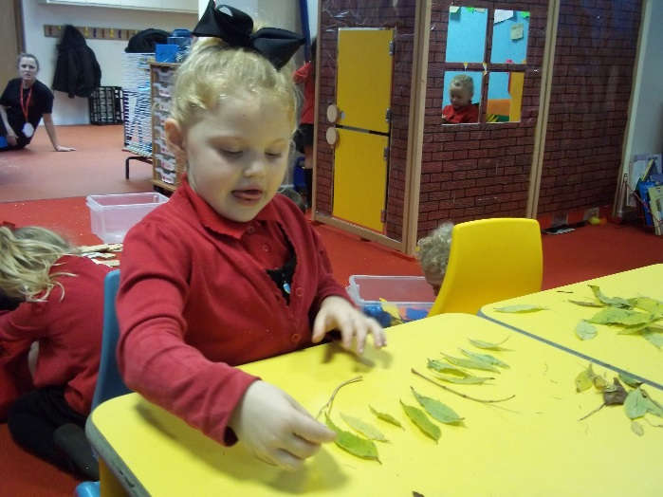
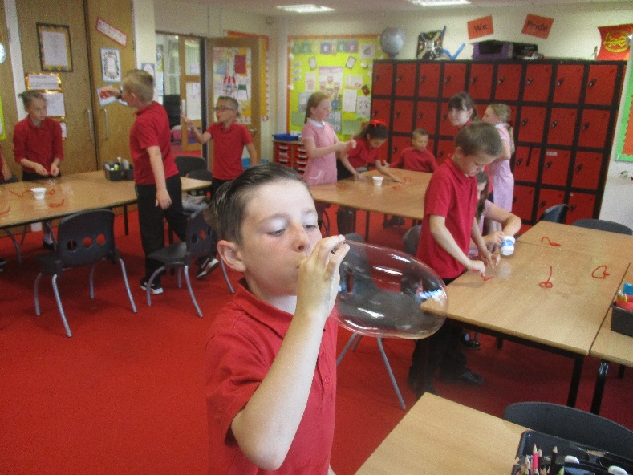
Science
At Northwick Park

Slide 2
We asked the children and staff what made Science at Northwick park so enjoyable. This is what they said…

Slide 3
we join in, are excited and have fun.
we get to think and talk about ideas, choose resources and decide what we want to investigate.
we ask questions to help us understand, we take risks and learn from our mistakes. We talk about what we have found out.
there are lots of great resources for us all to use.

Slide 4
our teachers know lots about our topics and during lessons they help us work out what we need to do next to learn more. Our teachers are happy to let us investigate for ourselves. Everyone knows where we are now and what our next steps are.
we learn about science inside and outside the classroom, using outside spaces, in the school grounds, in our local environment, and on school trips.
Science is celebrated across the school in a range of ways including science weeks, assemblies, clubs, visitors, displays and competitions.

Slide 5
These are our KEY PRINCIPLES and our teachers think about them when planning lessons, and when we are in Science lessons we think about which of them we are using.

Slide 6
Each class has a Science Ambassador who will meet regularly with the Science subject leaders to discuss how our key principles are improving lessons and what else we would like to work on in Science.

Slide 7


