Slide 1
Year 4 Multiplication Tables Check

Slide 2
The Multiplication Tables Check (MTC) is an on-screen assessment designed to determine whether pupils are able to fluently recall their multiplication tables up to 12, which is essential for future success in mathematics.
The MTC was trialled in June 2019 but this is the first year that it is a statutory requirement that all schools have to administer the check.

Slide 3
About the MTC
The MTC is a KS2 assessment that is taken by pupils at the end of year 4 and is based on the 2014 National Curriculum
It is focussed on the fluent recall of multiplication facts
The curriculum states, ‘By the end of Year 4, pupils should have memorised their multiplication tables up to and including the 12 multiplication table and show precision and fluency in their work’
The Year 4 programme of study also states, ‘Pupils should be taught to recall multiplication and division facts for the multiplication tables up to 12 x 12’
The MTC only assesses the instant recall of multiplication facts

Slide 4
When will the MTC be carried out
There is a 3 week window starting on the 6th June, for the administration of the check
There is no set day to administer the check
Children will not all take the check at the same time
All eligible year 4 pupils in England will be required to take the check

Slide 5
How is the MTC carried out
The check is fully digital and takes place on screen
Children will use a device they are use to and have practised on (desktop, laptop or tablet)
Answers will be entered using a keyboard or a touchscreen number pad
The check should take no longer than 5 minutes per pupil and will be administered by an adult that they are familiar with

Slide 6
What will the MTC involve
Children will get 6 seconds from the time the question appears to input their answer
There will be 25 questions with a 3 second pause in-between them
Each pupil will be randomly assigned their questions
They will only have to face multiplication statements (not related division facts)
There will always be questions from the 3,4,5,6,7,8,9,11 and 12 multiplication tables in each check
There will be no questions from the 1x table
There will be a maximum of 7 questions from the 2, 5 and 10 times tables
There is an emphasis on the 6,7,8,9 and 12 times tables as these are the most difficult

Slide 7
Specific arrangements for the MTC
Children with additional needs, who have adaptions made to their provision in school, may be allotted specific arrangements.
Changes to the colour of the background and questions
Font adjustments
Removing on-screen number pad
An adult to input answers
Question reader
Audible time alert

Slide 8
Reporting of the MTC
The pupils will not be told their score at the end of the check
Pupil results will be made available to schools later on in the term
It is likely that schools will be asked to report the result to parents at the end of the term
There is no pass mark
The school level data will not be published

Slide 9
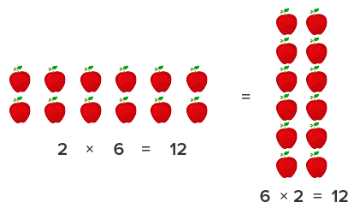
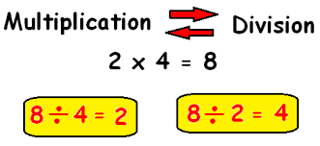
How do we teach times tables
Counting and looking for patterns
Repeated addition
Multiplication is commutative
Multiplication is the inverse of division
Number families
Using known facts
Repetition
Concrete manipulatives
Pictorial representation
Number songs and videos
Games
Online activities

Slide 10
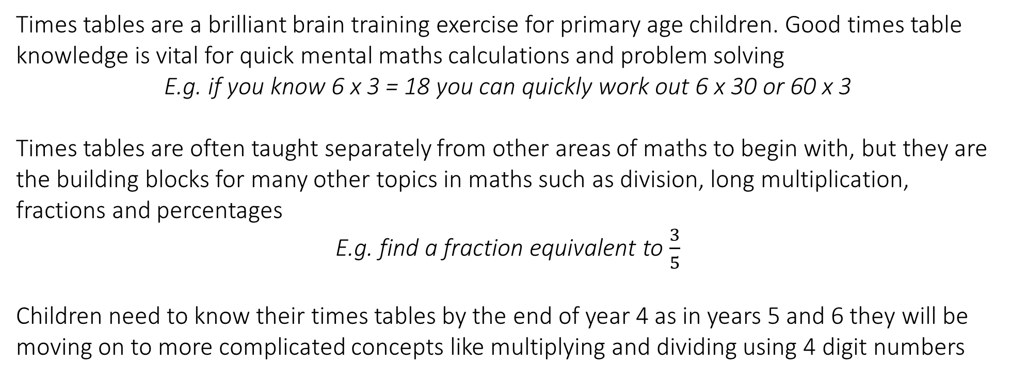
Why are multiplication tables so important
Times tables are a brilliant brain training exercise for primary age children. Good times table knowledge is vital for quick mental maths calculations and problem solving
E.g. if you know 6 x 3 = 18 you can quickly work out 6 x 30 or 60 x 3
Times tables are often taught separately from other areas of maths to begin with, but they are the building blocks for many other topics in maths such as division, long multiplication, fractions and percentages
E.g. find a fraction equivalent to $\frac{3}{5}$
Children need to know their times tables by the end of year 4 as in years 5 and 6 they will be moving on to more complicated concepts like multiplying and dividing using 4 digit numbers

Slide 11
Why are multiplication tables so important
Knowing multiplication facts will aid learning division facts. Once you know 6 x 3 = 18 you will be quicker recalling the answer to 18 ÷ 3. It is vital that we practise these alongside each other and although the MTC will not test them, the knowledge will be important for future maths work.
Your child may protest that timetables are useless, but we rely on them constantly in everyday life
E.g. for working out if you have enough oranges if they come in bags of 6 and you need one a day for three members of your family.
Remind them of everyday ways that they can put their times tables to use
E.g. In the cinema count how many seats in a row and the number of rows in the venue and work out the total number of people
Knowing times tables makes life easier in secondary school. Good multiplication skills are a great help when learning algebra, chemistry, physics, biology which rely on mathematical skills

Slide 12
How can you support your child
Make Times table fun:
Climb stairs counting in multiples
Play verbal times table games
Listen and learn table songs
Say the tables in different voices
Play online maths games
Display a poster with the times table facts on
Put tricky facts up around the house
Create flash cards with the answers on the back

Slide 13

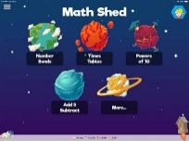
How can you support your child
All children have a log on for Times Table Rockstars. Encourage them to play as often as possible but for short periods of time as this will help them learn better than one long session a week.
Children can access Maths Shed through their Spelling Shed log in. This also has a section for times table practise.

Slide 14
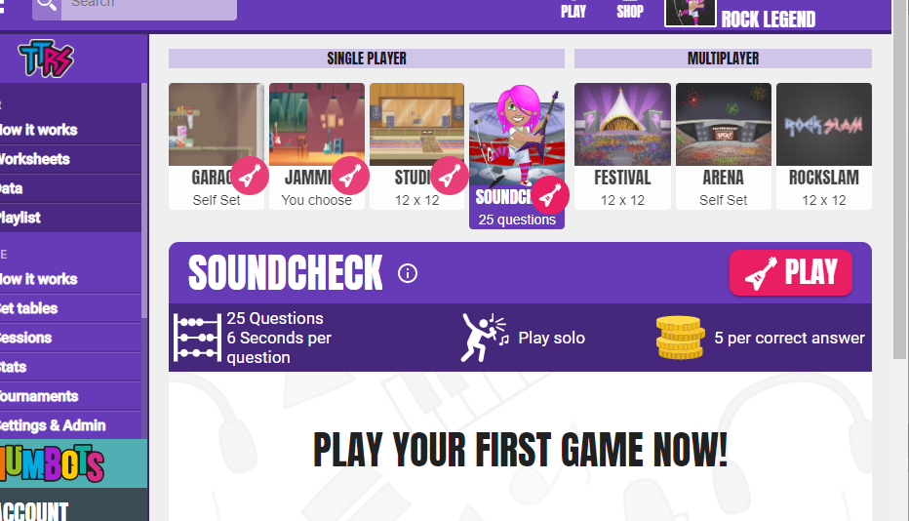
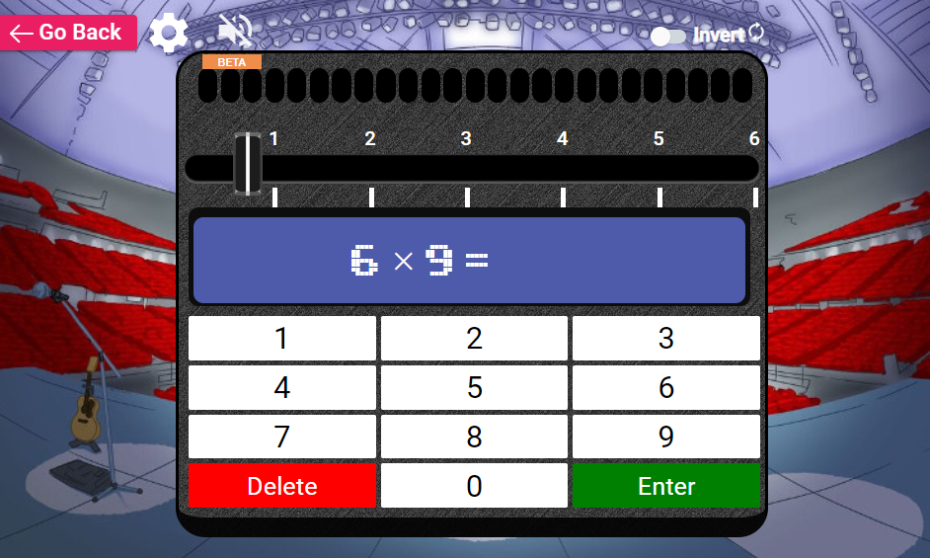
SOUNDCHECK on TTRS is set up so that children can practise for the MTC. They have 25 questions to answer and 6 seconds to answer them. This is good for them to see how long 6 seconds actually is!

Slide 15
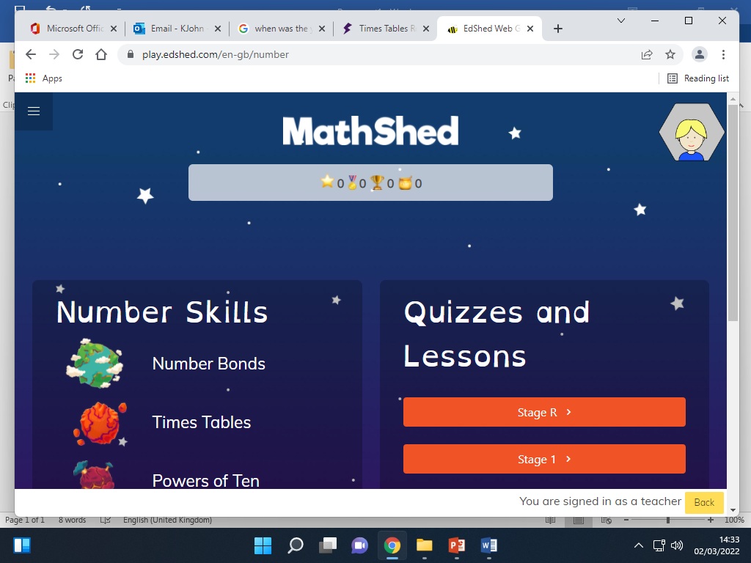
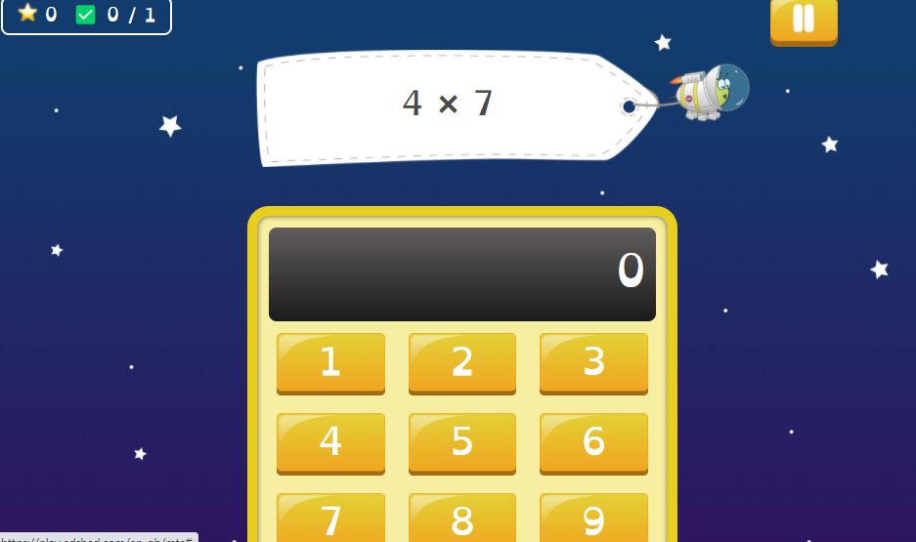
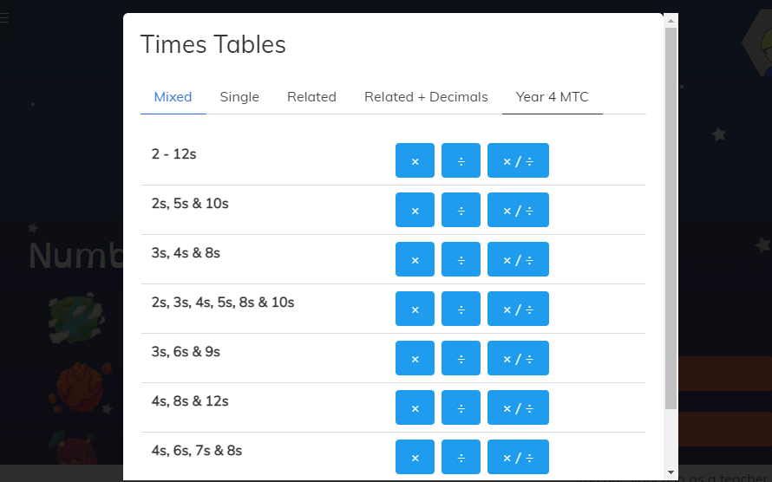
Maths Shed also has a practise MTC. You can find it in the Times table section.

