Slide 1
WALT analyse newspaper articles
Steps to Success
I can…
  Identify the key parts of a newspaper articles (e.g. Layout and structure)
  Identify language features (e.g. tense, punctuation and strategies)
  C. Explore the use of grammar.

Slide 2
Using your newspapers, talk to your partner about these questions:
What is the purpose of a newspaper?
How is a newspaper set out?
What is the structure? (paragraphs?)
What questions is it answering?
What punctuation can you see?
Is there anything else you have noticed?

Slide 3
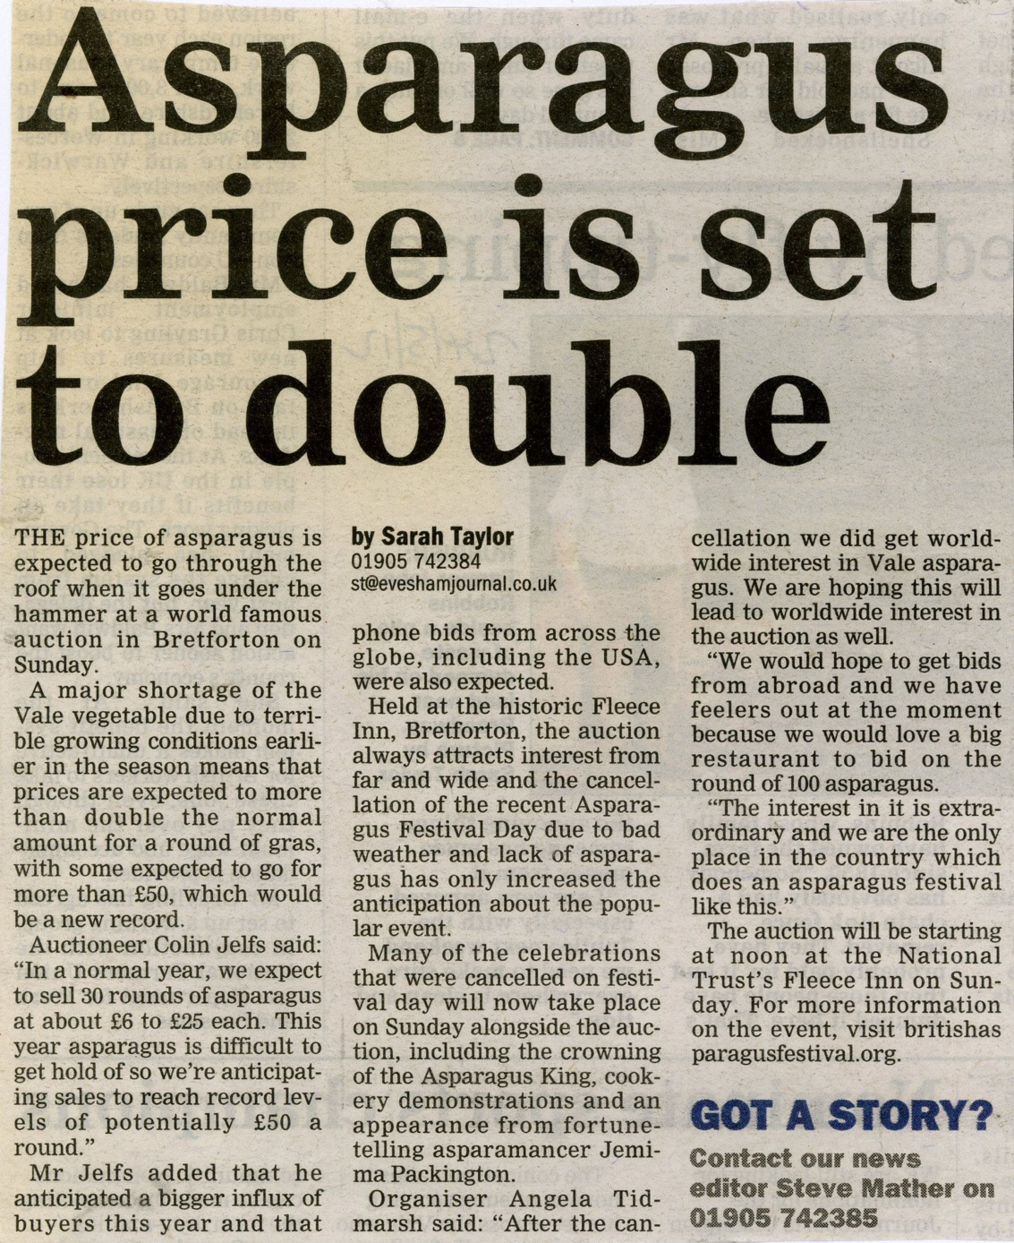
Layout of a newspaper
Who has written it (the journalist)
Contact information
Headline
Columns

Slide 4
Headlines
Short and to the point
Catchy
About the article (title)
Can be an alliteration
Interests the reader
Can have a play on words

Slide 5
Introduction/Opening
First paragraph
Will often answer all the 5Ws and H
  What has happened?
  When it happened?
  Where it happened?
  Who was involved?
  Why it has happened?
  How did it happen?

Slide 6
Main body
Will be the main part of the article.
Will often be more than one paragraph.
Explains and adds more detail about 5ws and H.
Can include quotations, photos and captions.

Slide 7
Summary/Conclusion
Will usually summarise/conclude what the article was about.
Will often tell us what is happening now, so will change from
past tense to present
tense.
May add some
extra information
or points of
contact

Slide 8


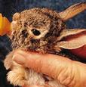
Photos
The photo shows us a snapshot of what happened, where it happened or who it happened to. It should make the reader “feel something” so that they want to read the article. If possible it should show action.

Slide 9
Caption
A caption goes underneath a photo to identify something or someone and to give us more information.
It is a label for the photograph!

